Slide 1
DataBase
Lab 3 Presentation
Zohaib

Slide 2
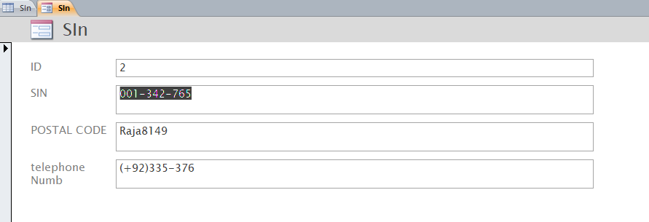
Forms
It is used for entering information in a meaningful and logical manners to store in database.
Example

Slide 3
Relationships:
Tables are related by relationships in order to minimize data redundancy. Such redundancy is both wasteful and can lead to anomalies.
Types of table relationships:
There are three types of table relationships.

Slide 4
A one-to-many relationship:
A one-to-many relationship exists in a relational database when one row in table A is linked to many rows in table B, but only one row in table B is linked to one row in table A.

Slide 5

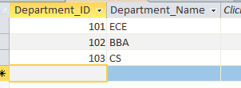
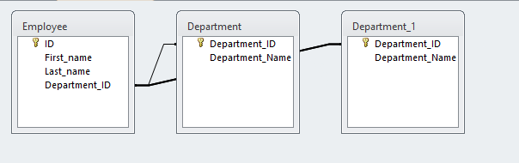
Example here we have established a one-to-many relationship between the Department and Employee tables. Each department can have multiple employees, but each employee can only be associated with one department.

Slide 6
A many-to-many relationship:
A Many-to-Many relationship is a relationship between several instances of one entity and multiple instances of another entity, i.e. both entities can have multiple relationships with each other.

Slide 7
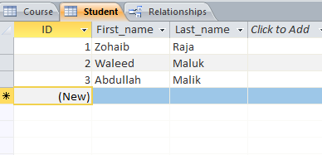
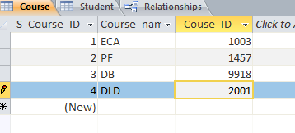
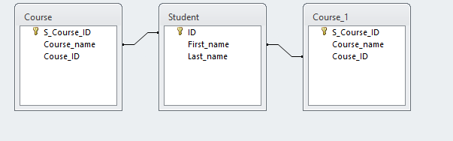
Example Each student can be associated with multiple courses, and each course can have multiple students enrolled in it. The Student Course junction table serves as a bridge to connect students and courses, allowing you to easily manage these relationships in a relational database system.

Slide 8
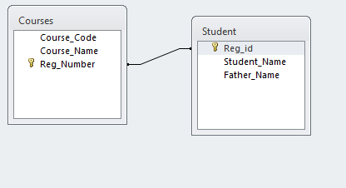
A one-to-one relationship
One-to-One relationship in DBMS is a relationship between an instance of an entity with another. An Employee is issued an Employee ID Card. An individual employee is offered a unique ID card in the company.
Example

